Slide 1

Mega Mart (Shopping cart)
Team 2
By:
Amit kumar, Anirudh Aggarwal, Hritik Kumar, Prayati Palliwal, Rishikant Kumar, Rohit Mohan

Slide 2

Introduction
A simple, user-friendly e-commerce solution for businesses.
Offers seamless online shopping and order management for customers.
For consumers, the website provides an enjoyable shopping experience with quick navigation and easy checkout.

Slide 3
Vision : To be the leading shopping cart platform globally, revolutionizing online shopping for both consumers and businesses through innovation, convenience, and cutting-edge technology.
01
Mission : To empower businesses and enhance the customer shopping experience by delivering a reliable, secure, and seamless shopping cart solution.
02
Purpose : Enable consumers to shop conveniently from anywhere, anytime, while offering a wide variety of products and services.
03

Slide 4
Objectives
Enhance E-commerce Accessibility
Improve User Experience
Ensure Scalability
Maximize Customer Retention

Slide 5

Technologies & Tools
Html
CSS
JavaScript
Docker
VS Code

Slide 6
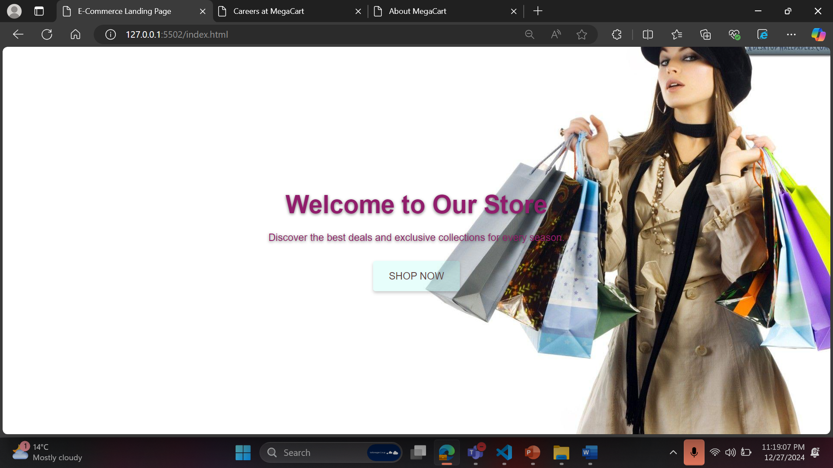

Slide 7
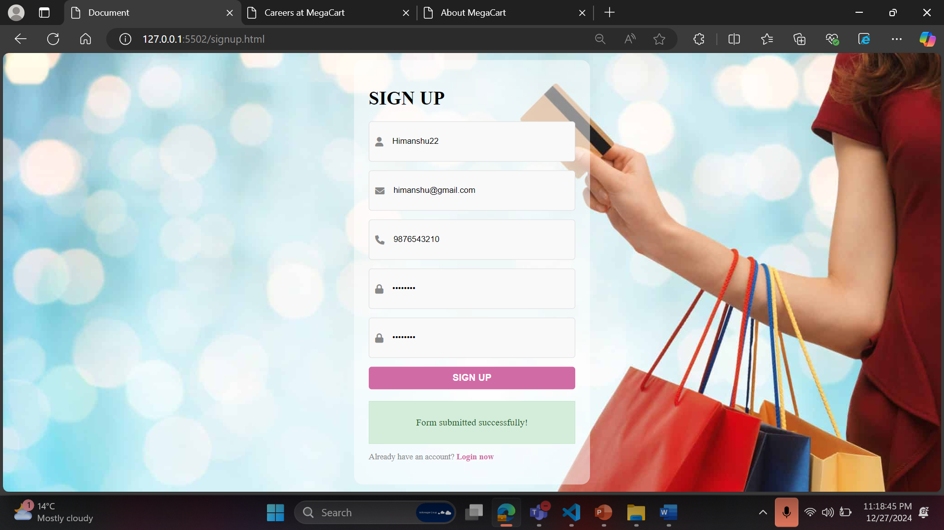

Slide 8
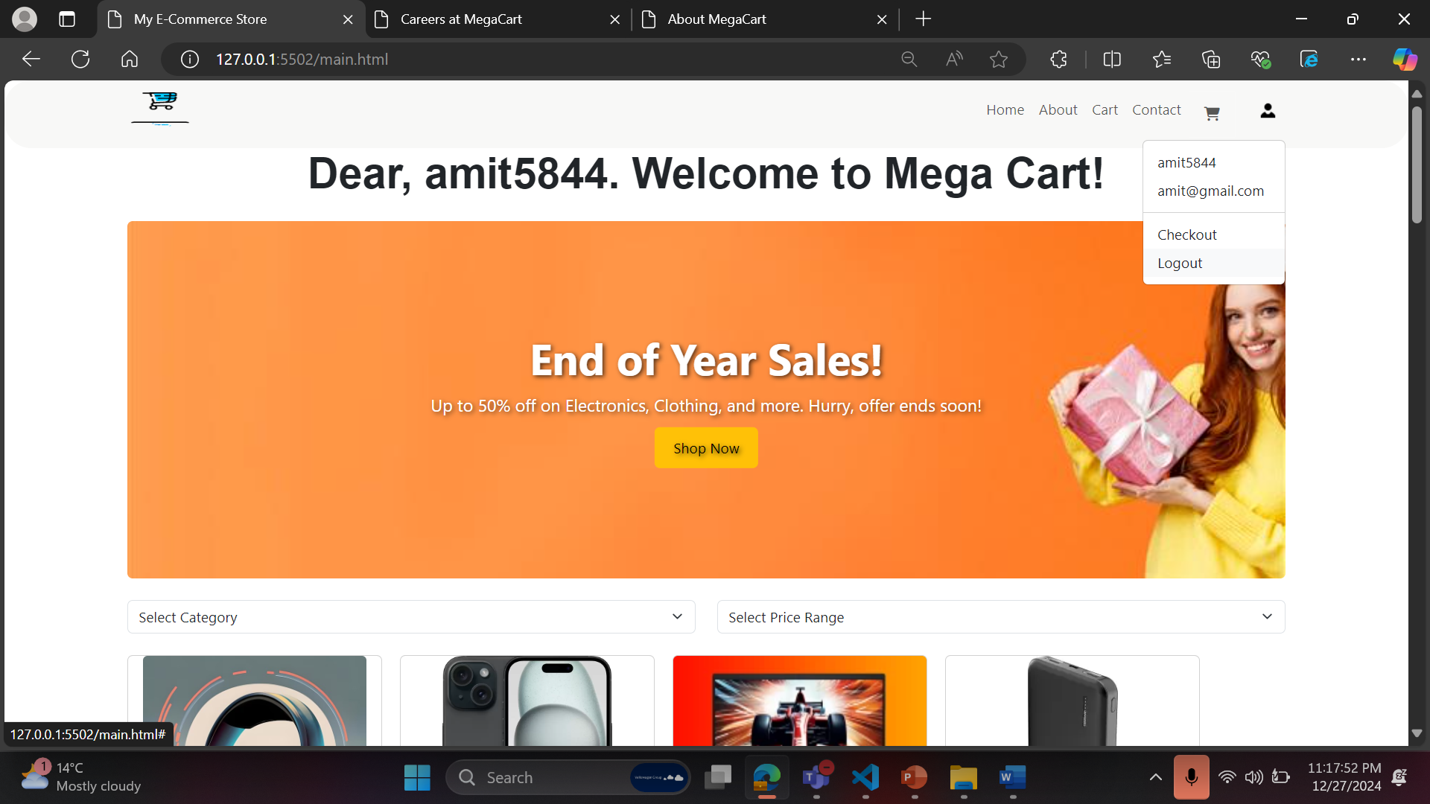

Slide 9

Future Scope
User Authentication
Wishlist Functionality-
Basic Analytics
Data Management
Backend Development
Payment Integration

Slide 10

Conclusion
Our shopping cart platform is built to help businesses grow by providing a seamless, secure, and intuitive shopping experience.
With a focus on innovation and customer satisfaction, we strive to create lasting relationships with our users and help them thrive in the digital marketplace.

Slide 11

Thank You

